Slide 1
Introduction to Computer Programming Lecture 4.2:
Function Arguments & Scope
Hemma Philamore
Department of Engineering Mathematics

Slide 2
Passing Arguments
Arguments allow you to pass parameters to a function (the input)
The part between () in the function definition tells you what arguments are expected.
We can have multiple arguments, separated by commas
The order of the arguments is important
You can define default arguments with the syntax MyArgument = Value, providing these arguments are then optional

Slide 3

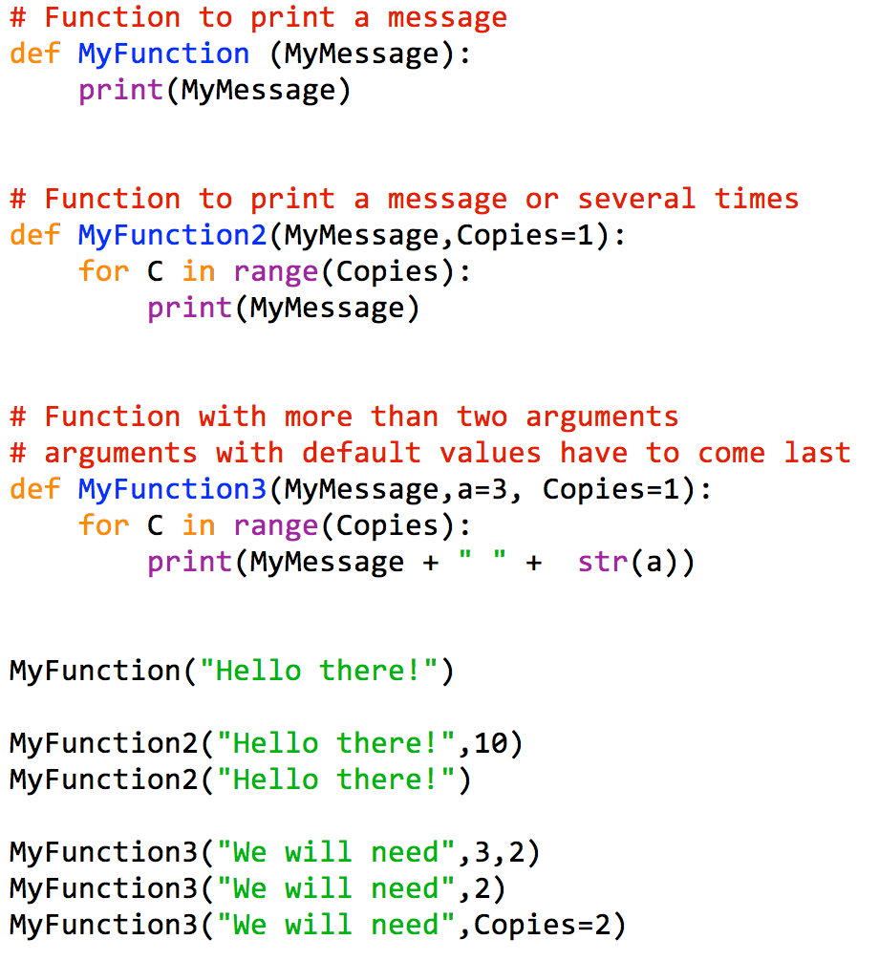
Passing Arguments
multiple arguments
using commas
Named argument:
default value
default values
have to come last
can use arguments
as variables later
change value
by using
named argument

Slide 4
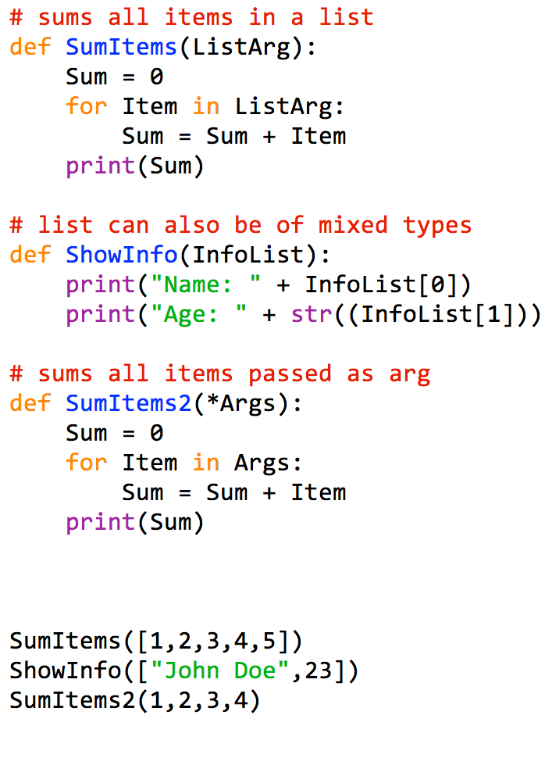
More Complex Arguments
goes through the list
call using list

Slide 5


More Complex Arguments
Sometimes we don’t know the exact number of inputs
Sum of numbers
ListArg = [1,4,5,6]
Solution (A): Input is one list
Solution (B): use the form *name - function receives a tuple containing all parameters
immutable

Slide 6
More Complex Arguments
Python puts arguments
in a tuple…
…goes through the tuple
Call with multiple items

Slide 7
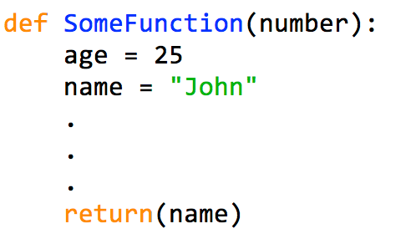

Variable Scope
Variables defined in the function are only local!
local variables
don’t exist
outside
number = 30
(local copy)
makes a copy
at return statement
b = “John”

Slide 8
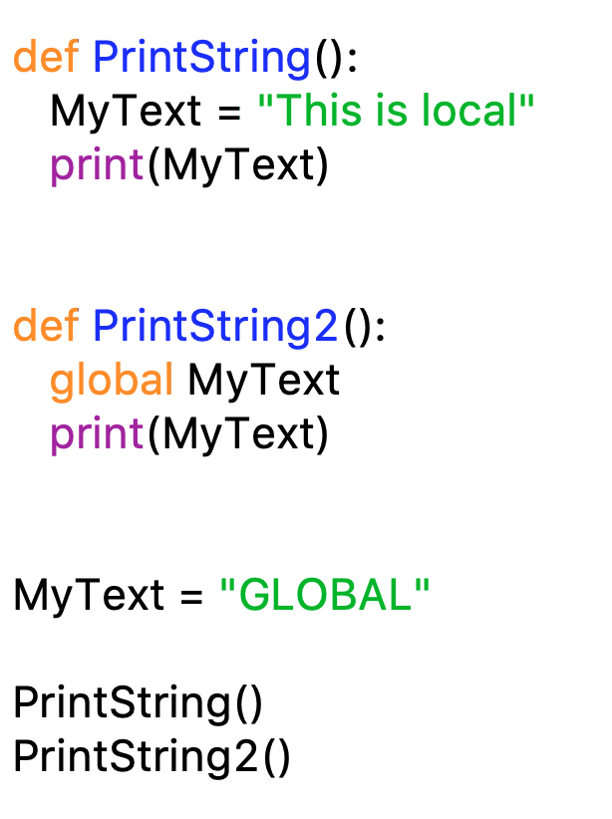
Variable Scope

